Slide 1
About the Course
The long 20th century will in all likelihood be seen in the future as the watershed in human experience:
Nine aspects:
History was economic…
Explosion of wealth…
Cornucopia of technology…
Demographic transition…
Feminist revolution…
Empowered tyrannies…
Wealth gulfs…
Inclusion and hierarchy attenuation…
Mismanagement and insecurity…
Humanity is unlikely to see as transformative—for good and ill, but mostly for good, I think—a century again…

Slide 2
U.C. Berkeley: Economics 115: Spring 2020
20th Century Economic History: Lecture 4: Empire and War
Brad DeLong
Department of Economics and Blum Center, U.C. Berkeley; and WCEG
delong@econ.berkeley.edu
last revised: 2020-02-03
for delivery: W 2020-02-05 17:00 HMMB390
<https://bcourses.berkeley.edu/courses/1487684>
<https://github.com/braddelong/public-files/blob/master/econ-115-lecture-4.pptx>

Slide 3
Empire
Chapters 6: Empire 1870-1914:
Empire in the age of an extraordinary technological gradient
Scrambles: For India, Egypt, Africa, informal influence in Latin America, and China. Herbert Hoover again!
Informal economic hegemony:
Emulating Britain looked good
Breaking Britain’s rules was costly
For privates, playing along was profitable
Freedom of investment
Japan’s Meiji Restoration

Slide 4
To Your iClickers!
According to Eichengreen, graphing international capital flows and mobility since 1850 over time produces a graph that is:
V-shaped
U-shaped
W-shaped
An upward line
None of the above

Slide 5
To Your iClickers!
According to Eichengreen, the responsibilities of a pre-World War I central as steward of the global gold standard and also as lender-of-last-resort in domestic financial crises were:
in complete harmony
in irresolvable tension
for the most part manageable, before World War I at least, via fancy footwork and good luck
not understood
none of the above

Slide 6
To Your iClickers!
According to Eichengreen, the experience of being on the gold standard for North Atlantic economies in the 1870-1914 period was by and large a happy one, and the experience of countries at the world economy’s periphery was:
also by and large a happy one.
a mixed one.
a source of considerable tension, instability, and political upset.
once again, manageable with fancy footwork and a little good luck.
none of the above.

Slide 7
To Your iClickers!
In Eichengreen’s view, if World War I had somehow been avoided, would the global gold standard have remained stable in the 1920s and 1930s?
There are no guarantees, but probably yes.
There are no guarantees, but probably no.
Certainly not!
Certainly yes—unless several North Atlantic economies experienced a socialist revolution
None of the above.

Slide 8
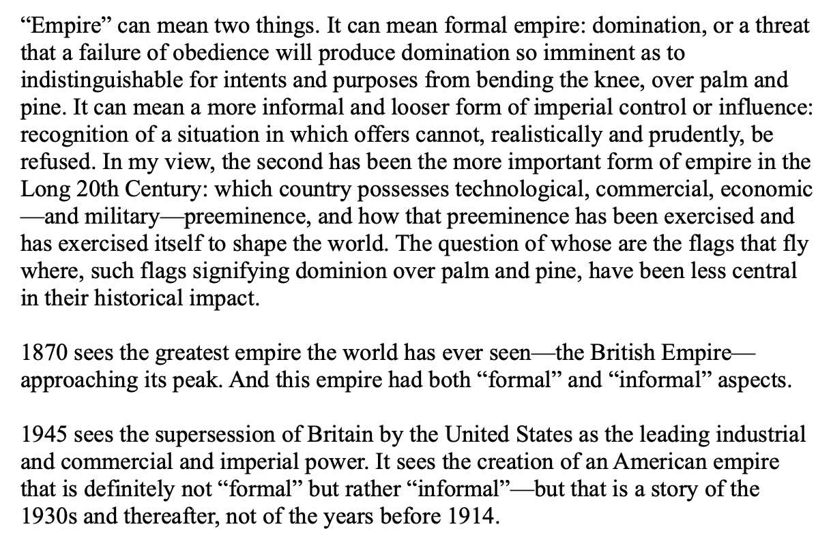
20th Century Empires
Huge but “loose”:

Slide 9
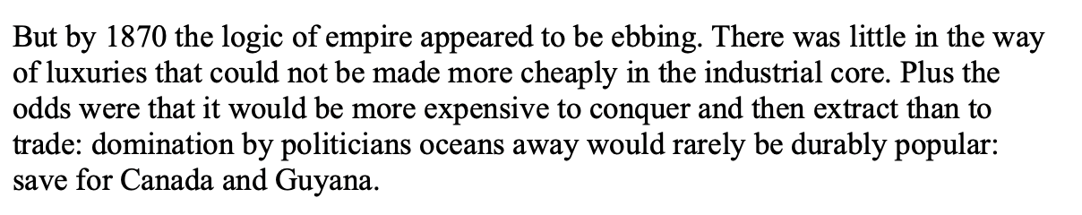
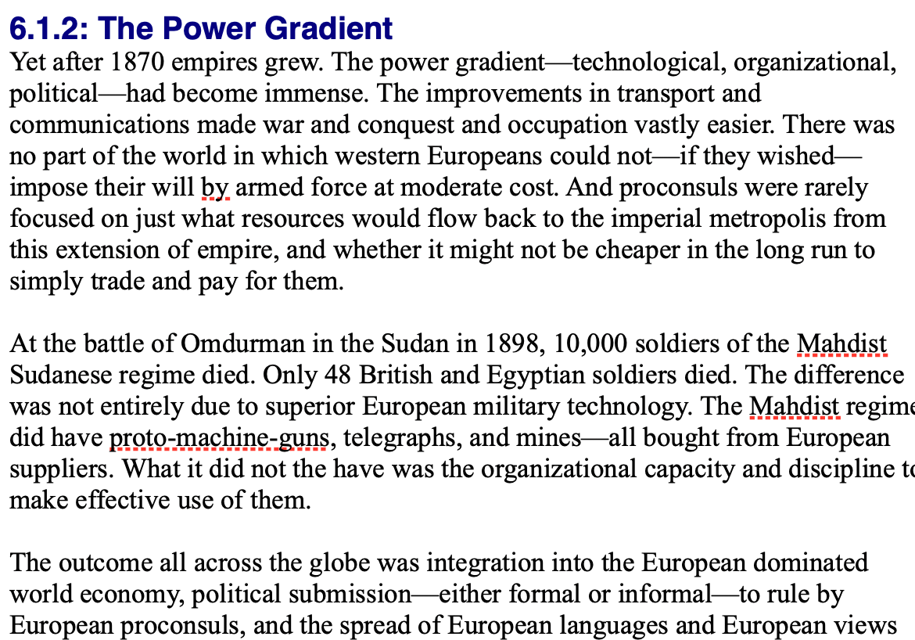
By 1810 the Tide of Empire Was Clearly Ebbing…
But things turn around: the power gradient

Slide 10
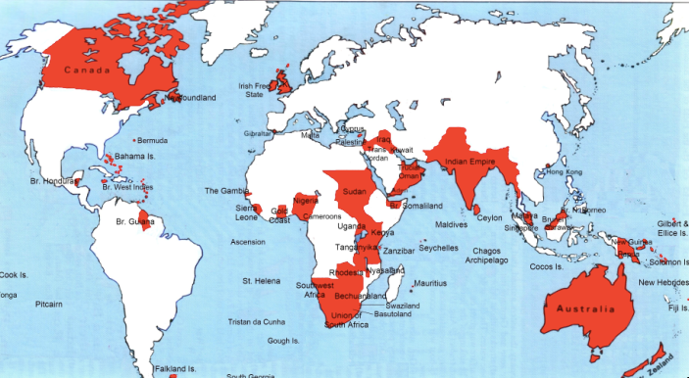
Empire

Slide 11
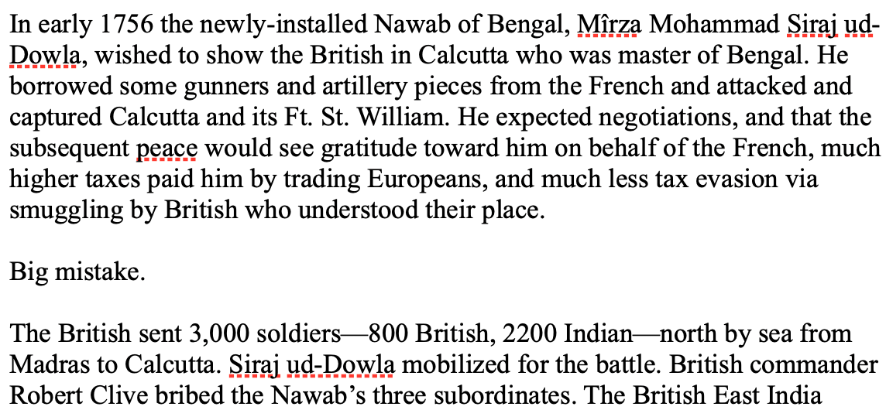
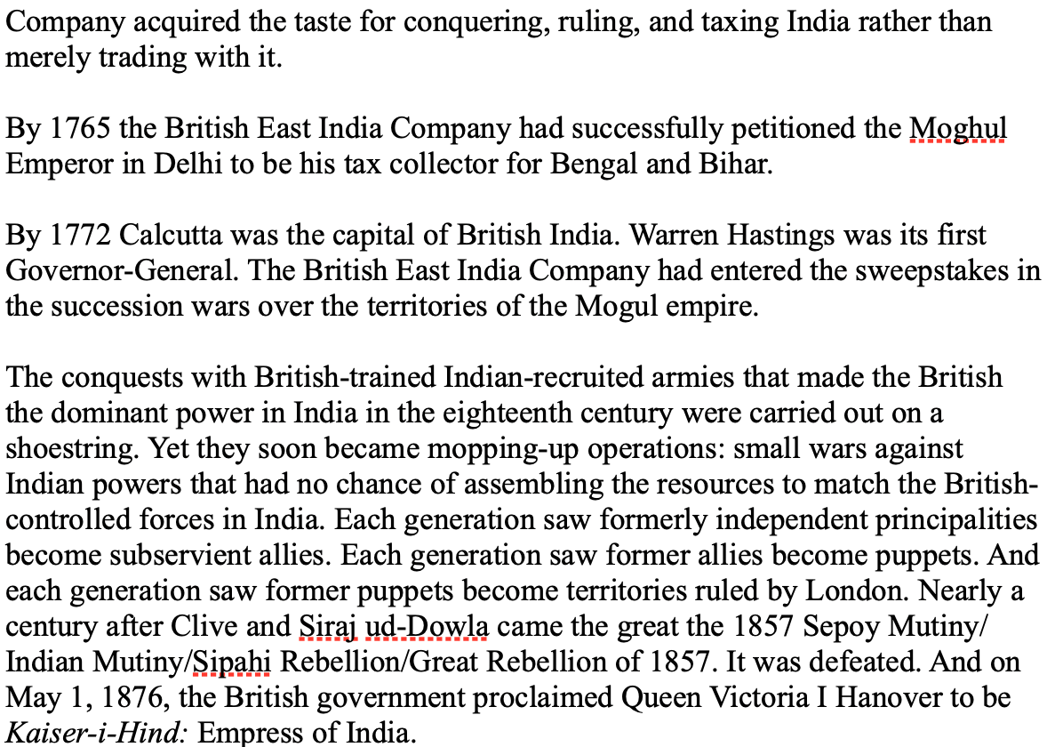
India
How do the British manage to conquer India?

Slide 12
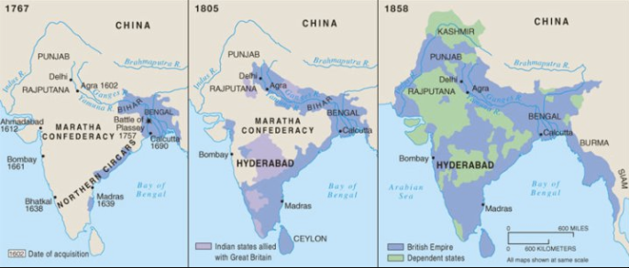
The Conquest of India
1767: Bombay, Madras, Calcutta, and tax collector for the collapsing Mogul Empire in Bengal and Oudh
1805: armies composed 3/4 of soldiers born in India; Viceroy Richard Wellesley’s conquest policy
1858: conquest complete with suppression of Sipahi Uprising

Slide 13
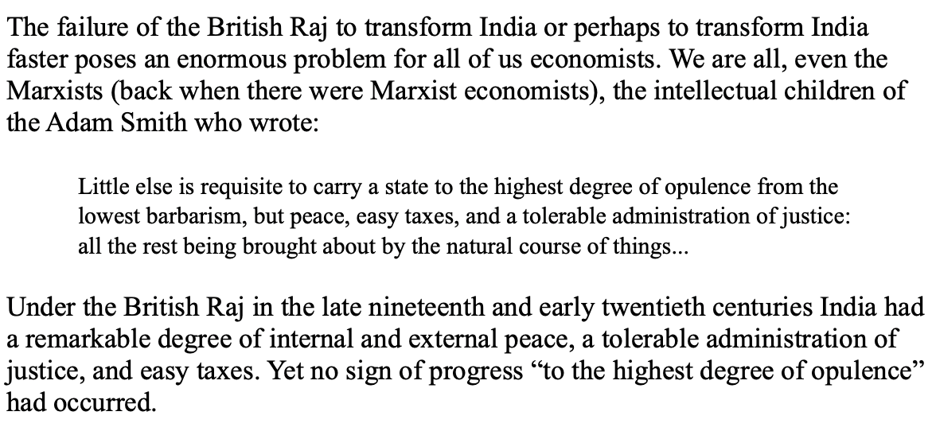
India
Why didn’t the British transform India into an industrial power?

Slide 14
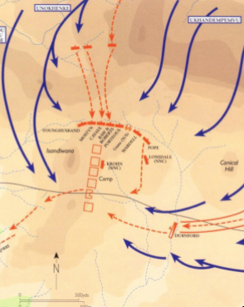
Isandlhwana
1879
Sir Henry Bartle Freer, High Commissioner for South Africa
His mandate: to “Canadaize” it…
Cape Colony
Natal
Boer Republics
Zululand
Lord Chelmsford with 15000 soldiers
The “horns and chest of the buffalo”
1300 British casualties—1300? Zulu
British reaction: “We can’t be beaten by n———“
As Cetshwayo had feared…

Slide 15
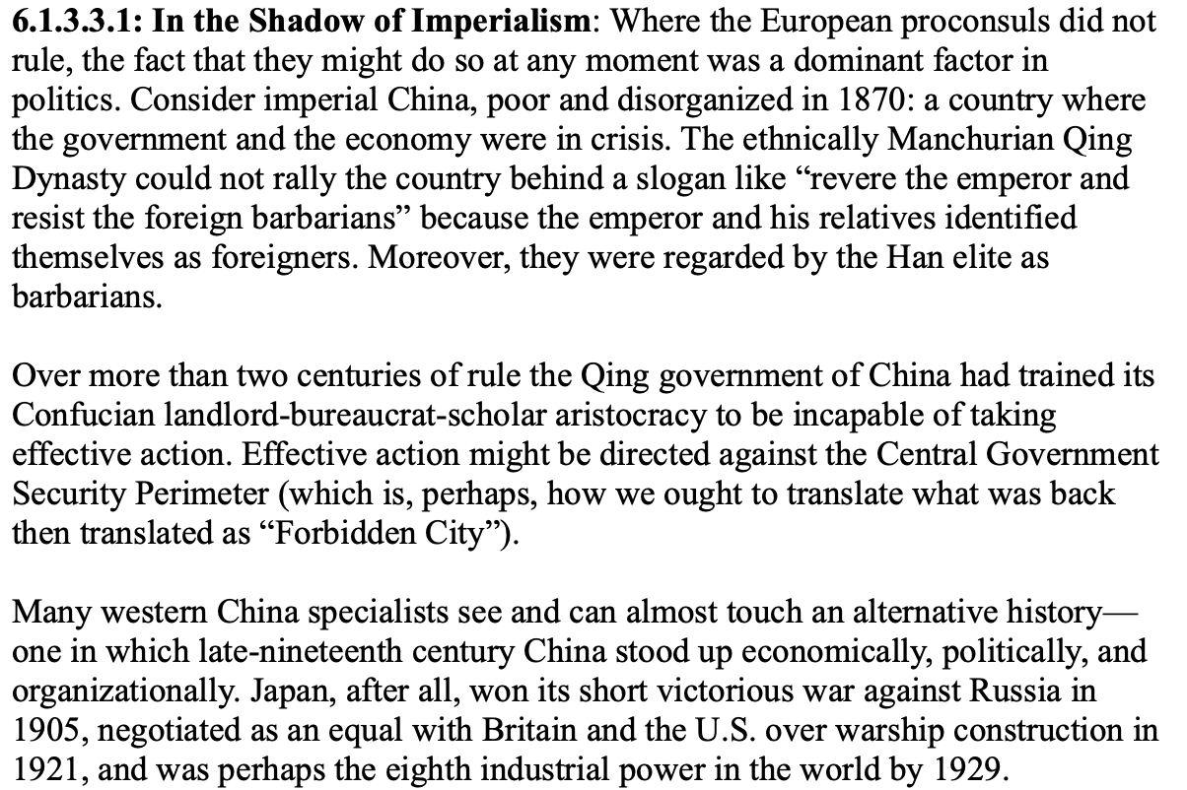
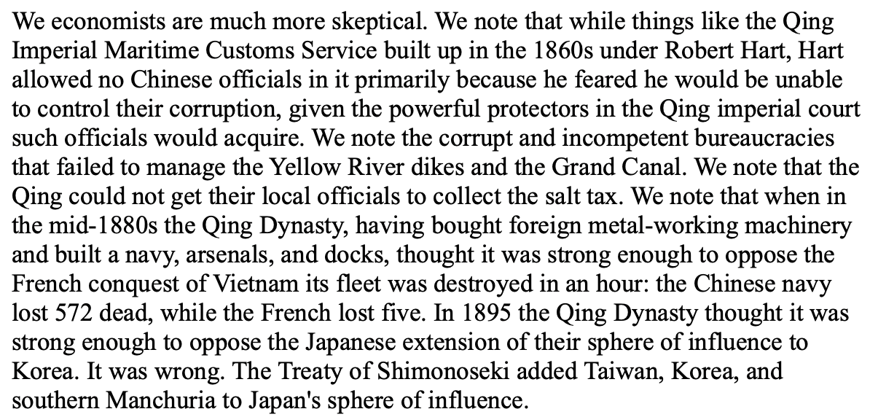
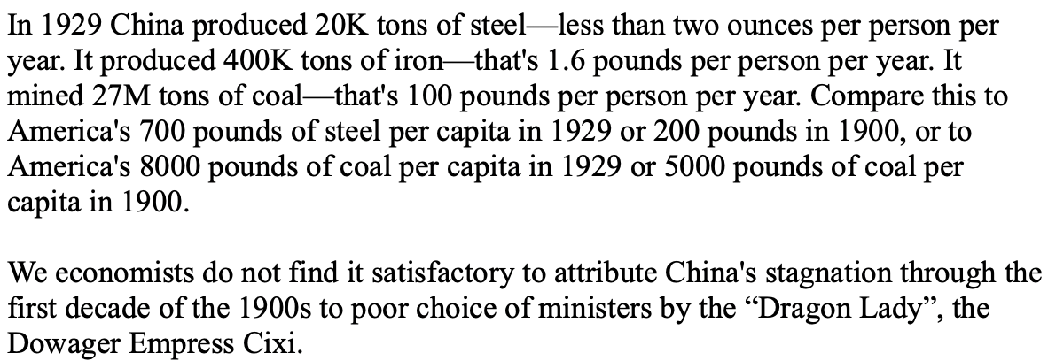
China
Why did 1870-1975 see China’s relative nadir?

Slide 16
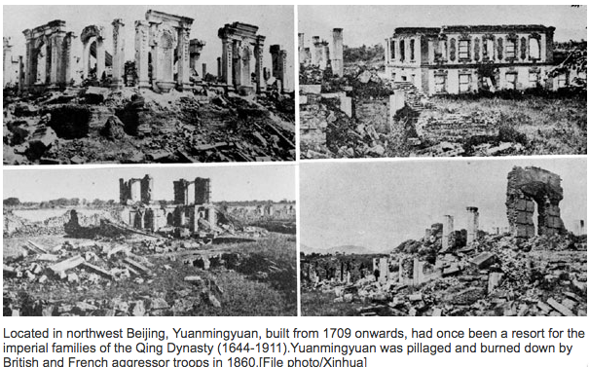
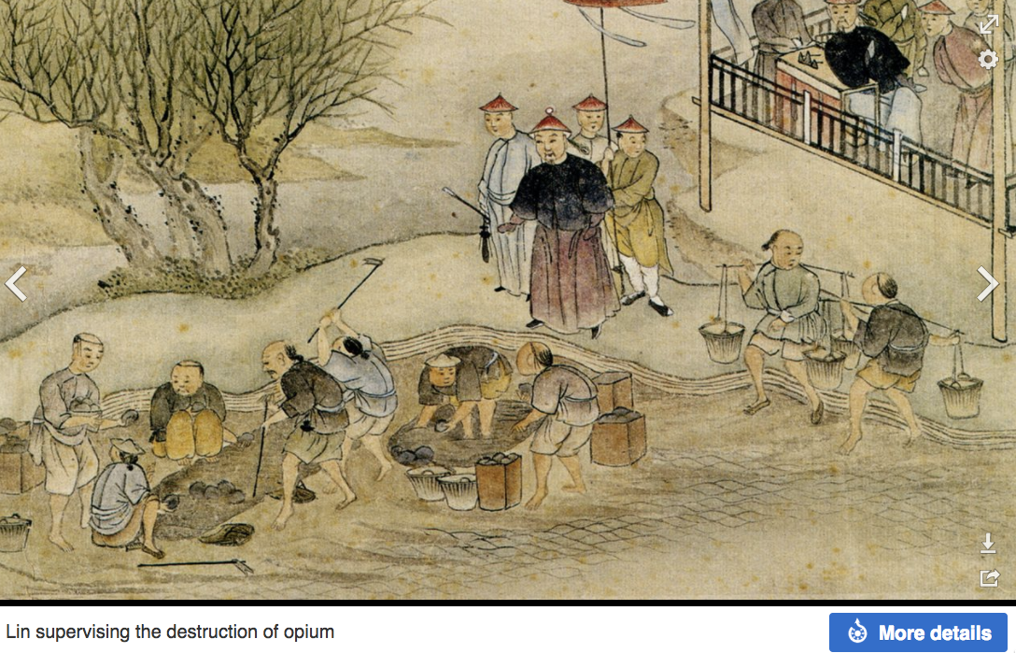
“Self-Strengthening”
The puzzle of China vs. Japan
Great Qing (大清)(1644-1912)
Wu Sangui (吳三桂)
The Rebellion of the Three Feudatories (三藩之亂)
Kangxi and Qianlong: “revere the emperor and expel the barbarians” is difficult to pursue when the emperor and his clan identify themselves as “barbarians”
Tai-Ping Rebellion (太平天國運動)
Cixi ( 慈禧太后)

Slide 17
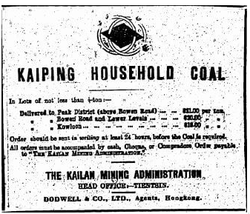
“Self-Strengthening” II
Li Hongzhang (李鴻章) and the Kai-Ping coal mine…
From 1881…
Build up an industrial base…
Opposition…
Chang Yen-Mao
Bannerman
“Boxers” (义和拳)
Herbert Hoover
Chang Yen-Mao vs. Moreing…
Li Hongzhang (李鴻章) “did not have the reputation for financial disinterest enjoyed by his patron Zeng Guofan (曾国藩)”

Slide 18
Formal Empires
There were, broadly, three views as to why European late-1800s empires rose to such domination, each of which with its own view of what was to be done to fix the situation:
One view is that of John Hobson: The major economic problem was the business cycle. Equipping the military needed to maintain the empire puts people to work. And an empire is a good source of consumers for the products of domestic factories. European governments that pursued empire, Hobson thought, were less likely to face economic distress and so more likely to continue in office.
A second view was that of Joseph Schumpeter: imperialism as the last gasp of military status aristocracy.
The third view was that empires were ordained by God—or at least morally required or desirable, for European powers had a civilizing mission. The Europeans were lucky enough to be the grownups, and it was the obligation of the grownups to civilize the world. But perhaps civilization is best spread by newspapers and books and merchants and engineers, rather than by alien proconsuls? Just a thought.

Slide 19
Informal Empires
But even where Britain (or France, or Germany, or Portugal, or Spain, or those who thought of themselves as descended from the conquistadores of Castile, or Anglo-Saxon settlers) did not rule, they reigned:
Britain seemed successful: playing by Britain’s rules seemed wise…
Britain was powerful: playing by Britain’s rules seemed likely to keep it from getting annoyed…
Britain was working very hard to make itself attractive—to make becoming a Briton-by-proxy of some sort straightforward and profitable in both money and cultural terms…
Britain was the first-mover hegemon: international cooperation was on its terms…

Slide 20
Catch Our Breath…
Comments?
Questions?

Slide 21
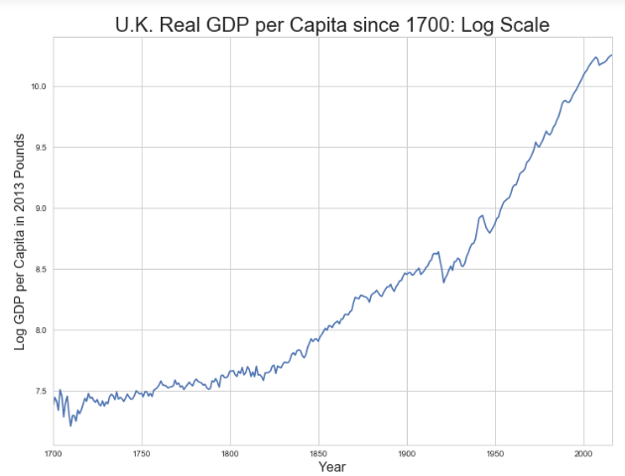
Skipped Topic: Passing the Baton: From Britain to America
The Industrial Revolution took place in Britain
The standard explanation four or five largely independent strands coming together.:
Limited government, security of property, and freedom of contract
Science and the technological tradition of sustained inquiry
Victory in the wars of the Commercial Revolution era
Machinery making, "tinkering", and "gadgets"—primarily made out of metal.
Coal in Britain—the only thing that made a steam engine potentially profitable.
Plus high elasticity of demand for leading-sector products…
http://bradford-delong.com brad.delong@gmail.com

Slide 22
iClickers: Why Breaktrhrough?
The principal reason that the Industrial Revolution took place in late eighteenth century Britain (rather than in Sung China, or Abbasid Baghdad, or Antonine Dynasty Rome, or during the Hellenistic Age) is:
A lack of human numbers thinking about problems of production
A lack of good means of communication—e.g. printing—for diffusing information about how to solve problems of production
A lack of experience using coal as an energy source
A lack of the incentive created by high real wages leading to a strong desire to make labor more productive
None of the above/not enough information
http://bradford-delong.com brad.delong@gmail.com

Slide 23
iClicker: Why Passing the Baton
The principal reason that the twentieth century was an American rather than a second British century was:
The United States’s aggressive and enthusiastic welcome of immigrants
The United States’s focus on broad-based technical education
The United States’s extraordinary abundance of natural resources driving high real wages and enormous incentives to build machines to manipulate matter
A U.S. government that took industrial development as a key policy goal, rather than being comfortable with laissez-faire
None of the above/not enough information
http://bradford-delong.com brad.delong@gmail.com

Slide 24
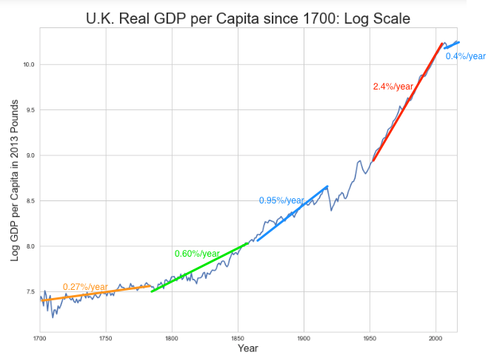
British Productivity Growth Acceleration
http://bradford-delong.com brad.delong@gmail.com

Slide 25
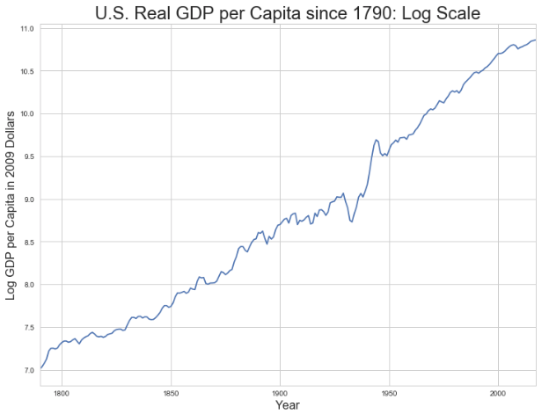
But Even in the First Half of the Nineteenth Century the U.S. Was Outpacing Britain in Growth…
Even in the first half of the nineteenth century—the period in which the British Industrial Revolution made it the wonder of the world—economic growth in the United States was proceeding faster than in Britain.
While British real GDP per capita was increasing at less than 0.6 percent per year
American was growing at a hair over one percent per year.
And a significantly larger share of GDP was going to the white working class in the United States, in the north at least:
The extraordinary abundance of land and the possibility of "lighting out for the territory", in the words of American author Mark Twain, gave even workers without property or notably scarce skills substantial economic bargaining power.
http://bradford-delong.com brad.delong@gmail.com

Slide 26
And Starting in the Late Nineteenth Century
Second Industrial Revolution…
Why the U.S. and Germany, and not Britain?
Immigration and Population
Was resource scarcity no longer a factor?
Was the differential in the growth rate h of the stock of useful economic knowledge even greater than the differential in the growth rate g of the efficiency-of-labor?
http://bradford-delong.com brad.delong@gmail.com

Slide 27
Phases of American Growth
1.0% per year in GDP per capita from 1760-1860: resource abundance
1.6% per year in GDP per capita from 1860-1929:
“Great traverse”: K/Y ratio up from 2.5 to 4
Half of it an increase in savings rates
Half of it a fall in the price of capital goods
2.5% per year in GDP per capita from 1929-1973
“Fordism”
Expected further acceleration: it did not happen
Post-1973
Productivity slowdown 1973-1995 (environment, oil, baby boom, feminism)
“New economy” 1995-2006
Post-2006 collapse of growth
http://bradford-delong.com brad.delong@gmail.com

Slide 28
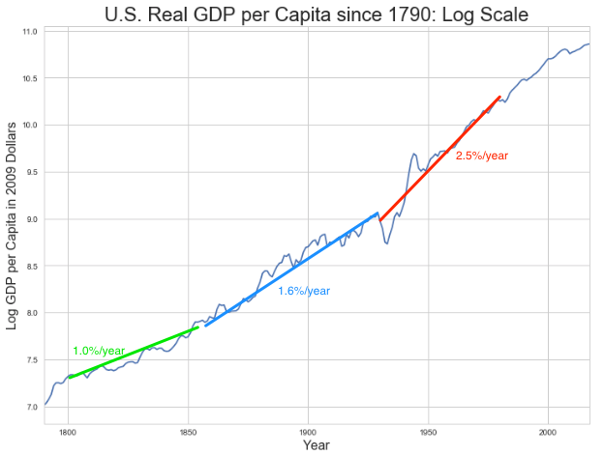
American Productivity Growth Acceleration
http://bradford-delong.com brad.delong@gmail.com

Slide 29
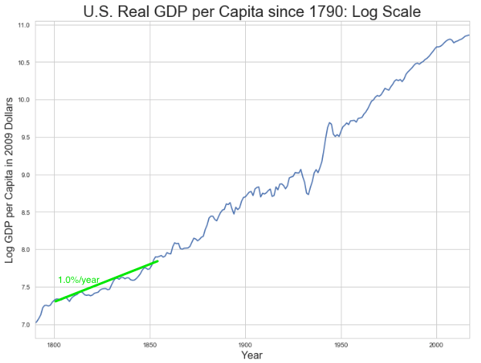
Early Nineteenth Century: Westward Expansion
Westward expansion
The “American System”
Abundant natural resources
Very high real wages
Focus on raising labor productivity
Hence fast efficiency-of-labor growth
Britain, by contrast, focused on economizing on (non-coal) raw materials
http://bradford-delong.com brad.delong@gmail.com

Slide 30
The Importance of Resources 1760-1860
Major westward expansion and "Amerindian removal”
The century 1760 to 1860 before the Civil War.
We have U.S. output-per-worker growth then at about 1.0% per year…
…in contrast to British output-per-worker growth at about 0.5% per year.
We have the U.S. population and labor force growing at 2.5% per year…
…from 2.5 to 30 million.
http://bradford-delong.com brad.delong@gmail.com

Slide 31
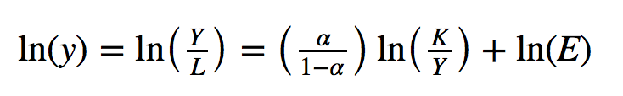
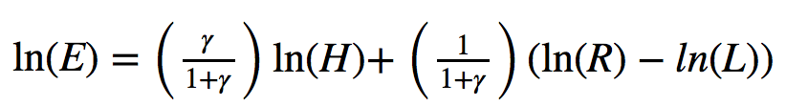
The Importance of Resources 1760-1860
Recall our basic Solow Model:
http://bradford-delong.com brad.delong@gmail.com

Slide 32
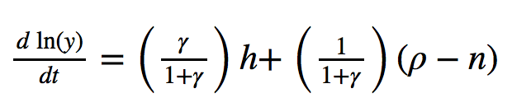
The Importance of Resources 1760-1860
Recall our basic Solow Model:
Assume K/Y constant, so the growth rate g of the efficiency of labor and the growth rate of output-per-worker are the same:
http://bradford-delong.com brad.delong@gmail.com

Slide 33
The Importance of Resources 1760-1860
Recall our basic Solow Model:
Assume K/Y constant, so the growth rate g of the efficiency of labor and the growth rate of output-per-worker are the same:
http://bradford-delong.com brad.delong@gmail.com

Slide 34
The Importance of Resources 1760-1860
Recall our basic Solow Model:
Assume K/Y constant, so the growth rate g of the efficiency of labor and the growth rate of output-per-worker are the same:
Let’s, last, fit this to history in the century before the 1860 election of President Abraham Lincoln and the ensuing American Civil War:
http://bradford-delong.com brad.delong@gmail.com

Slide 35
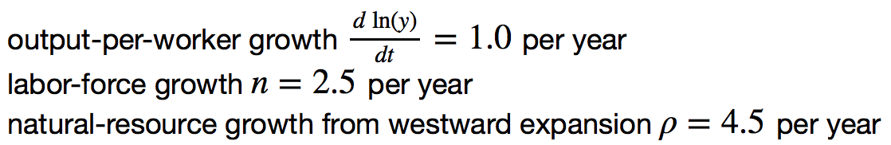
The Importance of Resources 1760-1860
Recall our basic Solow Model:
Assume K/Y constant, so the growth rate g of the efficiency of labor and the growth rate of output-per-worker are the same:
Let’s, last, fit this to history in the century before the 1860 election of President Abraham Lincoln and the ensuing American Civil War:
http://bradford-delong.com brad.delong@gmail.com

Slide 36
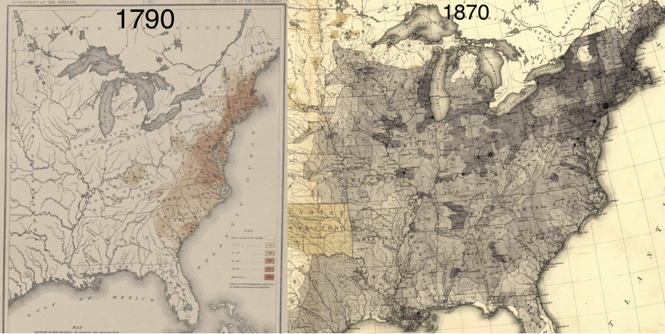
Westward Expansion
http://bradford-delong.com brad.delong@gmail.com

Slide 37
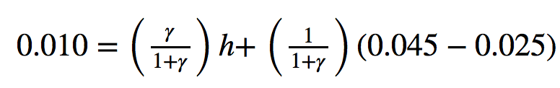
The Importance of Resources 1760-1860
We have two parameters left: γ and h, the weight of ideas in efficiency-of-labor growth and the rate of growth of the stock of useful ideas for the economy in American heads, respectively:
http://bradford-delong.com brad.delong@gmail.com

Slide 38
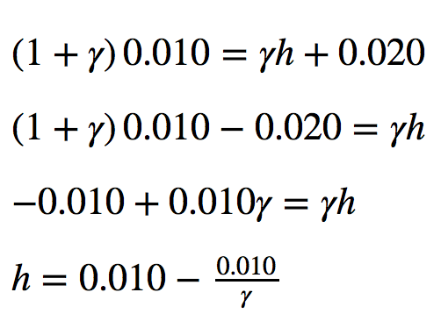
The Importance of Resources 1760-1860
We have two parameters left: γ and h, the weight of ideas in efficiency-of-labor growth and the rate of growth of the stock of useful ideas for the economy in American heads, respectively:
http://bradford-delong.com brad.delong@gmail.com

Slide 39
The Importance of Resources 1760-1860
Thus if γ→∞ then h→0.010
http://bradford-delong.com brad.delong@gmail.com

Slide 40
The Importance of Resources 1760-1860
Thus if γ→∞ then h=0.010
Thus if γ=3.0 then h=0.00667
http://bradford-delong.com brad.delong@gmail.com

Slide 41
The Importance of Resources 1760-1860
Thus if γ→∞ then h=0.010
Thus if γ=3.0 then h=0.00667
Thus if γ=1.0 then h=0.00
http://bradford-delong.com brad.delong@gmail.com

Slide 42
The Importance of Resources 1760-1860
Thus if γ→∞ then h=0.010
Thus if γ=3.0 then h=0.00667
Thus if γ=1.0 then h=0.00
Looking across the Atlantic Ocean to Great Britain, we see that over there it is indeed the case that h=0.005 from 1760 to 1860. Faster growth of h in America due to some catchup with the world's first and leading industrial nation seems likely. So γ=3.0 has some claim to be the most likely value…
http://bradford-delong.com brad.delong@gmail.com

Slide 43
A Counterfactual
The Royal Proclamation of October 1763:
Our Royal Will and Pleasure… no... Governor or Commander in Chief in... our... Colonies or Plantations in America do... grant Warrants of Survey, or pass Patents for any Lands beyond the Heads or Sources of any of the Rivers which fall into the Atlantic Ocean from the West and North West, or upon any Lands whatever, which, not having been ceded to or purchased by Us as aforesaid, are reserved to the said Indians, or any of them...
http://bradford-delong.com brad.delong@gmail.com

Slide 44
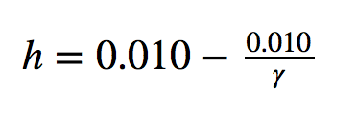
What If This Royal Proclamation Had Stuck?
What if ρ=0?
If γ → ∞ and h=0.010 then g=0.01
If γ=3.0 and h=0.00667 then g=−0.00125
If γ=1.5 and h=0.000 then g=−0.01
http://bradford-delong.com brad.delong@gmail.com

Slide 45
What If This Royal Proclamation Had Stuck?
What if ρ=0?
If γ → ∞ and h=0.010 then g=0.01
If γ=3.0 and h=0.00667 then g=−0.00125
If γ=1.5 and h=0.000 then g=−0.01
An America penned behind the Appalachians would probably have seen its living standards and productivity levels not growing at 1% per year from 1760 to 1860 but shrinking.
For γ=3.0, living standards and productivity levels would have shrunk at a pace of -0.125% per year
http://bradford-delong.com brad.delong@gmail.com

Slide 46
What If This Royal Proclamation Had Stuck?
What if ρ=0?
Of course, a poorer America would probably have seen fewer immigrants.
But it might not have seen that many fewer immigrants.
It would no longer have been quite as attractive to move from Britain to America over 1760 to 1860.
But it still would have been very attractive to move from France, Germany, Scotland—or most of all from Potato Blight-ridden Ireland...
In what other ways might this counterfactual alternate-history "little America" would likely have been different in 1860 than America actually was?
http://bradford-delong.com brad.delong@gmail.com

Slide 47
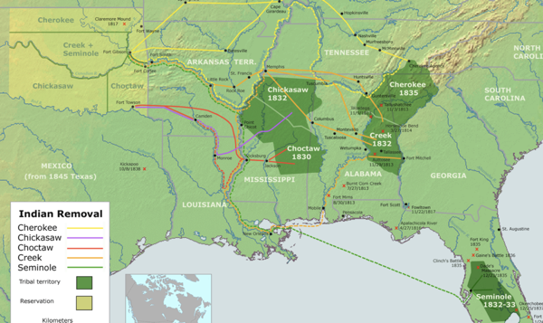
“Trail of Tears’
http://bradford-delong.com brad.delong@gmail.com

Slide 48
A large chunk of America's pre-1860 visible growing prosperity was based not just on African-American slavery, but also on "Amerindian removal"
http://bradford-delong.com brad.delong@gmail.com

Slide 49
Catch Our Breath…
Ask me two questions…
Make two comments…

Slide 50
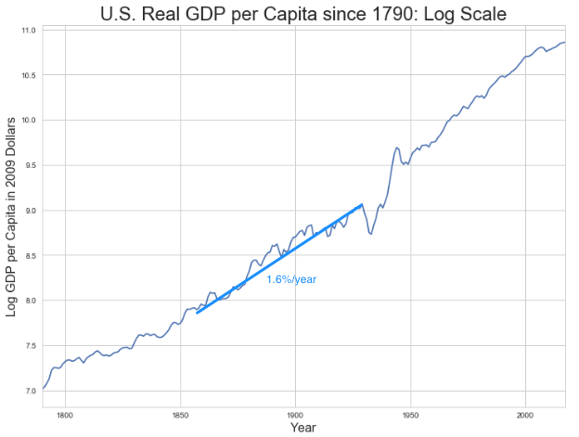
Late Nineteenth-Early Twentieth Century: “Great Traverse”
Invention of the industrial research lab
First globalization
Technologies of Second Industrial Revolution
Economies of scale and mass production
Falling price of capital goods
Greater savings effort
Rapidly rising inequality
Or was it?
http://bradford-delong.com brad.delong@gmail.com

Slide 51
Capital Deepening
Lowered deprecation rate δ
From 5% to 3% per year
http://bradford-delong.com brad.delong@gmail.com

Slide 52
Capital Deepening
Lowered deprecation rate δ
From 5% to 3% per year
Increased savings rate s
Capital-output ratio goes from 2.5 to 4 across 70 years
http://bradford-delong.com brad.delong@gmail.com

Slide 53
Capital Deepening
Lowered deprecation rate δ
From 5% to 3% per year
Increased savings rate s
Capital-output ratio goes from 2.5 to 4 across 70 years
with an α=1, output-per-worker proportional to the capital-output ratio
ln(4/2.5)/70 = 0.007
g = 0.9%/year
http://bradford-delong.com brad.delong@gmail.com

Slide 54
Capital Deepening
Capital-output ratio goes from 2.5 to 4 across 70 years
with an α=1, output-per-worker proportional to the capital-output ratio
ln(4/2.5)/70 = 0.007
g = 0.9%/year
Second Industrial Revolution
Large managerial corporation
Large-scale investment banking
Industrial research lab
Continent-wide market
Globalization
http://bradford-delong.com brad.delong@gmail.com

Slide 55
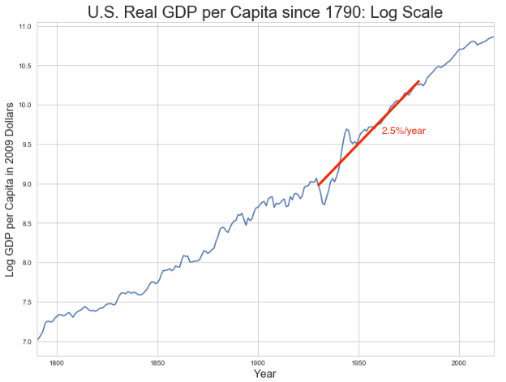
Mid Twentieth Century: Drive to High Mass Consumption
DARPA, etc.: two heads are better than one
“Fordist” oligopolies
Second globalization
Keynesian stabilization policies
Falling and then low inequality
For white guys…
http://bradford-delong.com brad.delong@gmail.com

Slide 56
Mid Twentieth Century: Drive to High Mass Consumption
DARPA, etc.: two heads are better than one
“Fordist” oligopolies
Second globalization
Keynesian stabilization policies
Falling and then low inequality
For white guys…
http://bradford-delong.com brad.delong@gmail.com

Slide 57
Catch Our Breath…
Ask me two questions…
Make two comments…

Slide 58
Econ 115: Administration: Office Hours &c.
DeLong: Office Hours
M 11:10-12:40, Blum Hall 200B
T 11:15-12:00, Blum Hall 200B
By appointment in Blum Hall 200B, Evans 691A, or elsewhere: email <delong@econ.berkeley.edu> Sign up at: <https://www.icloud.com/numbers/0leoOOlezWp6BYKSiPJhdXy7Q>
Paper due Feb 9: What Is Economics?: Assignment 3
UCLA professor Stephen Bainbridge believes that Partha Dasgupta's Economics: A Very Short Introduction is a bad book. He wrote, in his Amazon review: “1.0 out of 5 stars: Very disappointing, September 25, 2007: If you're looking for a VSI to Econ 101 and 102, skip this book. The treatment of microeconomic basics consists of exactly 14 pages. Macroeconomic theory gets a whopping 4 pages. The rest consists mainly of a political tract on wealth and poverty. It's the first VSI whose title amounts to a misrepresentation…"
Partha Dasgupta, of course disagrees. Which do you tend to agree with? (You can say that you are in the middle, but setting out and defending an "in the middle" position is actually very hard here.) Explain why and to what extent you come down on Dasgupta's or on Bainbridge's side of this dispute. Justify your opinions by setting out what you think economics is, or ought to be.
Write 400-500 words, and submit them on this webpage: <https://bcourses.berkeley.edu/courses/1487684/assignments/8051996>
By now you should have read not just Dasgupta but Eichengreen chapters 1 & 2
Memo: bCourses website <https://bcourses.berkeley.edu/courses/1487684>

Slide 59
Paper
Due Feb 9: What Is Economics?: Assignment 3
UCLA professor Stephen Bainbridge believes that Partha Dasgupta's Economics: A Very Short Introduction is a bad book. He wrote, in his Amazon review: “1.0 out of 5 stars: Very disappointing, September 25, 2007: If you're looking for a VSI to Econ 101 and 102, skip this book. The treatment of microeconomic basics consists of exactly 14 pages. Macroeconomic theory gets a whopping 4 pages. The rest consists mainly of a political tract on wealth and poverty. It's the first VSI whose title amounts to a misrepresentation…"
Partha Dasgupta, of course disagrees. Which do you tend to agree with? (You can say that you are in the middle, but setting out and defending an "in the middle" position is actually very hard here.) Explain why and to what extent you come down on Dasgupta's or on Bainbridge's side of this dispute. Justify your opinions by setting out what you think economics is, or ought to be.
Write 400-500 words, and submit them on this webpage: <https://bcourses.berkeley.edu/courses/1487684/assignments/8051996>

Slide 60
DeLong Office Hours
M 11:10-12:40, Blum Hall 200B
T 11:15-12:00, Blum Hall 200B
By appointment in Blum Hall 200B, Evans 691A, or elsewhere:
email <delong@econ.berkeley.edu>
Sign up at: <https://www.icloud.com/numbers/0leoOOlezWp6BYKSiPJhdXy7Q>

Slide 61
Memo
By now you should have read not just Dasgupta but Eichengreen chapters 1 & 2
bCourses website <https://bcourses.berkeley.edu/courses/1487684>

Slide 62
War: World War I
Chapter 7: War 1914-19
Empire and war
The knot of war
Economic illogic
Nationalism
Rehearsal: The Boer War
WWI proper
That DFT in the Balkans;
Germany attacks Belgium; w
Why not a short war?;
The Prussian way of war;
German technology and industry;
Attrition and exhaustion;
10 million dead, 10 million maimed, 1 full year of world income thrown down the sewer…

Slide 63
South Africa

Slide 64
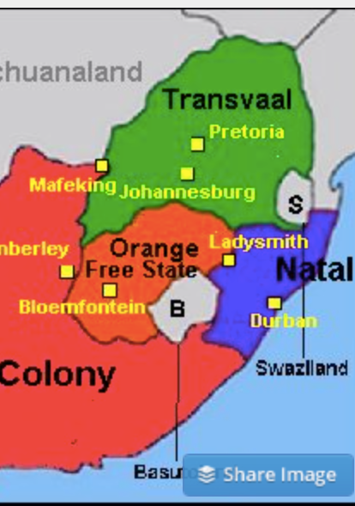
The South African Gold Rush
Remember the Zulu War?
Afterwards, the mandate to “Canadaize” South Africa put on hold…
But then the Witwatersrand…
Back up
The Great Trek
1886 Transvaal gold strike
100,000 (English speaking miners etc. in Johannesburg)
200,000 Boers
By 1913: 1M Dutch, English; 500K Indians, others; 2.5M Zulu, Tswana…

Slide 65
Convince the Boers…
The 1895 Jameson Raid
Joseph Chamberlain in 1899: equal rights for British citizens, or war
Boers struck in October 1899
40K British soldiers in South Africa
50K male Boers of potential military age
Mafeking, Ladysmith, Kimberley, Spion Kop, Vaal Kranz, Magersfontein, Stormberg, Tugela River…
Did the British negotiate?
Sent 250K soldiers
Competent commander, Lord Roberts
Boers turned to guerrilla war
British invented the concentration camp
Boer population of 200K—30K dead after the war: 10K soldiers, 15K children, 5K women and elderly.
British deaths: 8K in battle, 14K of disease
African deaths: 30K?
1900 “Khaki election”

Slide 66
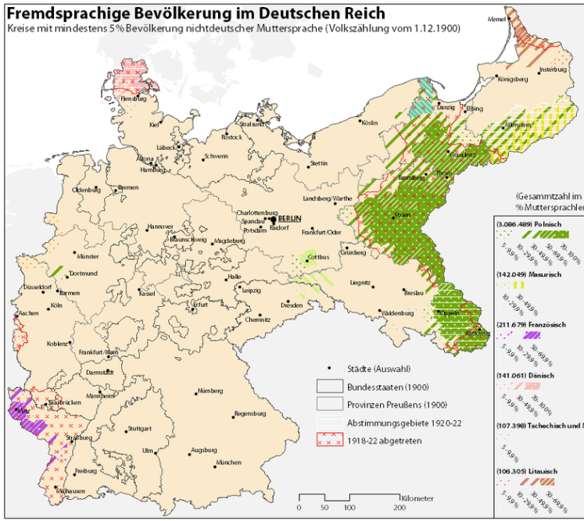
Nationalism
German sociologist Max Weber:
“The German character of the East... should be protected... the economic policy of the state should enter into the lists in its defense.... The economic struggle between the nationalities follows its course even under the semblance of ‘peace’…. The vulgar conception of political economy is that it consists in working out recipes for making the world happy.… However… elbow-room… can [only] be won… through the hard struggle.... That standard of value adopted by a German economic theorist, can… be nothing other than a German policy and a German standard.... Our successors will... hold us responsible... for the amount of elbow-room we conquer.... The science of political economy is... a servant of... the lasting political-power interests of... our nation's power, and the vehicle of that power, the German national state…”

Slide 67
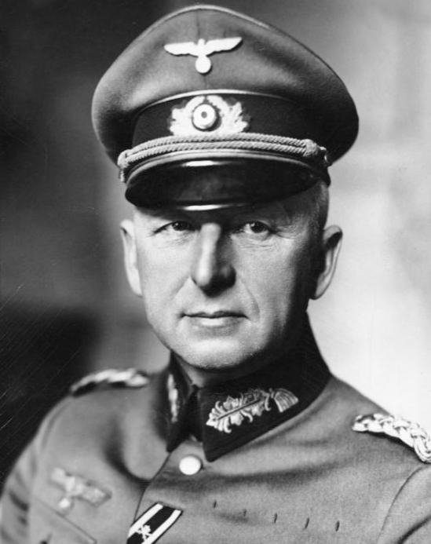
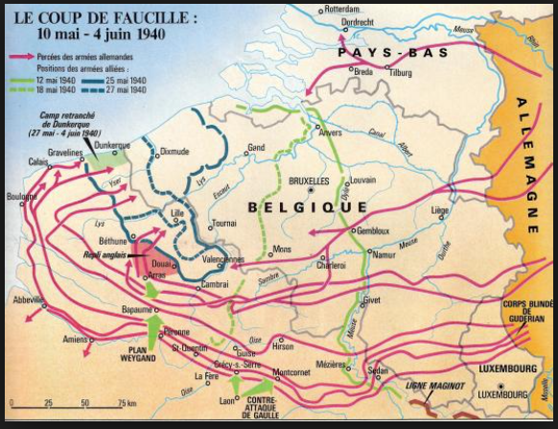
Erich von Manstein
von Manstein
von Lewinsky
Lewinski
Levi

Slide 68
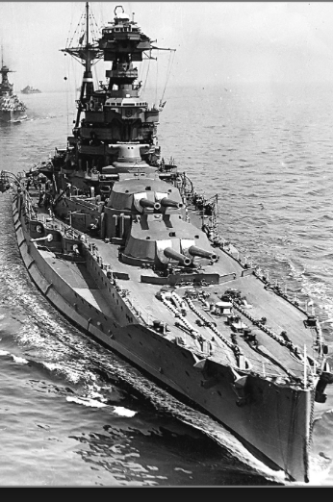
“We Offered 4, the Navy Demanded 6…
…and we compromised on 8…”
French politics welcomes a rematch…
Germany wants its place in the sun…
the German battlefleet to command “respect”
Russia seeks a short victorious war
Austria-Hungary wants to repel Balkan nationalism
Busying giddy minds with foreign quarrels?

Slide 69
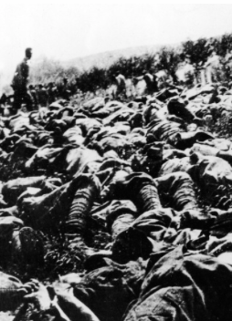
The Catastrophe of World War I: Origins
In the summer of 1914 the empires of Russia and Austria-Hungary are skirmishing diplomatically and threatening each other militarily about the latest Balkan crisis
Began when in the summer of 1914 the Archduke Franz Ferdinand and his wife Sophie were assassinated in Sarajevo
By terrorists with very close links to the intelligence service of the Kingdom of Serbia
What would Austria’s response be?
And then Germany attacks Belgium
And then Australia attacks Turkey

Slide 70
The Catastrophe of World War I: Causes
Why?: “If there is a war, let it come now…”
Russia thought it would have to fight Germany someday, and might as well while France was interested…
Austria, France, Britain (as a result of the German battle fleet) the same
“Busy giddy minds with foreign quarrels…”
A wiser man: Otto von Bismarck:
“There is nothing in the Balkans worth the bones of a single Pomeranian grenadier…”

Slide 71
The Catastrophe of World War I: Conduct
The machine gun and the artillery piece—and barbed wire
The trench line
Attrition warfare
Tank and the monoplane…
The worst generals ever
Alternatives?
Outflank (Constantinople, Salonika)
Blockade
The mystery of the German battle fleet

Slide 72
How Did the Germans Lose?
Outproduced 3-1
Short of raw materials
And, ultimately, of food
Tactical and operational success
Prussia
Fehrbellin
Friedrich II “the Great”
Metternich the moronic
Strategic, logistical, and grand-strategic catastrophe

Slide 73
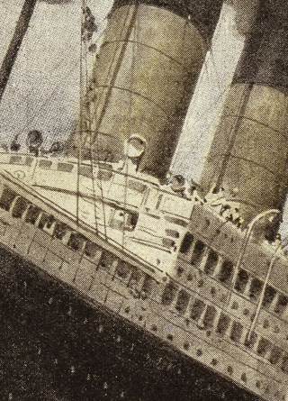
How Does the U.S. Get Involved?
British policy: binding the U.S. upper class to Britain since the 1840s
The Law of the Sea
Neutrals
Blockade
The submarine
Unrestricted submarine warfare
Zimmerman Telegram
Woodrow Wilson
“Teach the Mexicans to elect good men…”
“The war to end war…”

Slide 74
The Catastrophe of World War I: Outcome—Political
Russian, Austro-Hungarian, Ottoman Turkish Empires all gone…
Representative governments destabilized—or weak…
The Russian Revolution…
Hungarian, Bavarian socialist republics (short-lived)
Spartakist…
Allies demand 2 years of German GDP as “reparations”…

Slide 75
The Catastrophe of World War I: Outcome—Human
Combatants had mobilized 65M out of 100M men of military age
10M killed
10M maimed
Civilian casualties less than 10% of military
Costs of 1.5x a year’s GDP
Plus a 15M global flu epidemic

Slide 76
Catch Our Breath…
Comments?
Questions?

Slide 77
Takeaways
Chapters 6 & 7: Empire and War 1870-1914:
Empire in the age of an extraordinary technological gradient
Scrambles: For India, Egypt, Africa, informal influence in Latin America, and China. Herbert Hoover again!
Informal economic hegemony:
Emulating Britain looked good
Breaking Britain’s rules was costly
For privates, playing along was profitable
Freedom of investment
Japan’s Meiji Restoration
War
The knot of war
Economic illogic
Nationalism
Rehearsal: The Boer War
That DFT in the Balkans; Germany attacks Belgium; why not a short war?; the Prussian way of war; German technology and industry; attrition and exhaustion;
10 million dead, 10 million maimed, 1 full year of world income thrown down the sewer…

Slide 78
Preview: Next Time
On to Chapter 8: After World War I: Restoring? Civilization?:
Exhaustion: The Belle Époque Broken
The End of Aristocracy
The Birth of “Really Existing Socialism”
Social Democracy
Government Finances, Inflation, and “Reparations”
Keynes’s Protest
Post-WWI Economic Disorder
“The Deliberate Intensification of Unemployment”

Slide 79
What Was Unconvincing Today?
Mistakes and unclarities: typos, wordos, and mindos…
In the DRAFT textbook?
In the lecture?

Slide 80
Catch Our Breath…
Ask a couple of questions?
Make a couple of comments?
Any more readings to recommend?

Slide 81

Edward Bellamy: Looking Backward
Edward Bellamy: Looking Backward <https://delong.typepad.com/files/bellamy-backward.pdf>: Perhaps the third best-selling novel of the 19th century in the United States
2000 is a utopia…
The narrator is carried forward in time from 1887-2000 by an implausible plot device:
‘“This is the tenth day of September in the year 2000, and you have slept exactly one hundred and thirteen years, three months, and eleven days…”’
He then wanders around, looking at the utopia of 2000…
The opening:
‘“How could I live without service to the world?” you ask…. The answer is that my great-grandfather had accumulated a sum of money on which his descendants had ever since…. The sum had been originally by no means large. It was, in fact, much larger now that three generations had been supported upon it in idleness, than it was at first…’

Slide 82
The Stagecoach of Society
Those who ride and this who pull:
‘Commiseration was frequently expressed by those who rode for those who had to pull the coach, especially when the vehicle came to a bad place in the road, as it was constantly doing, or to a particularly steep hill. At such times, the desperate straining of the team, their agonized leaping and plunging under the pitiless lashing of hunger, the many who fainted at the rope and were trampled in the mire, made a very distressing spectacle, which often called forth highly creditable displays of feeling on the top of the coach.
‘At such times the passengers would call down encouragingly to the toilers of the rope, exhorting them to patience, and holding out hopes of possible compensation in another world for the hardness of their lot, while others contributed to buy salves and liniments for the crippled and injured. It was agreed that it was a great pity that the coach should be so hard to pull, and there was a sense of general relief when the specially bad piece of road was gotten over. This relief was not, indeed, wholly on account of the team, for there was always some danger at these bad places of a general overturn in which all would lose their seats.
‘It must in truth be admitted that the main effect of the spectacle of the misery of the toilers at the rope was to enhance the passengers’ sense of the value of their seats upon the coach, and to cause them to hold on to them more desperately than before…

Slide 83
The Stagecoach of Society II
“Finer clay”:
‘The other fact is yet more curious, consisting in a singular hallucination which those on the top of the coach generally shared, that they were not exactly like their brothers and sisters who pulled at the rope, but of finer clay, in some way belonging to a higher order of beings who might justly expect to be drawn. This seems unaccountable, but, as I once rode on this very coach and shared that very hallucination, I ought to be believed.
‘The strangest thing about the hallucination was that those who had but just climbed up from the ground, before they had outgrown the marks of the rope upon their hands, began to fall under its influence. As for those whose parents and grand-parents before them had been so fortunate as to keep their seats on the top, the conviction they cherished of the essential difference between their sort of humanity and the common article was absolute. The effect of such a delusion in moderating fellow feeling for the sufferings of the mass of men into a distant and philosophical compassion is obvious.
‘To it I refer as the only extenuation I can offer for the indifference which, at the period I write of, marked my own attitude toward the misery of my brothers…

Slide 84
The Stagecoach of Society III
Class war:
‘The sanguine argued very forcibly that it was in the very nature of things impossible that the new hopes of the workingmen could be satisfied, simply because the world had not the wherewithal to satisfy them. It was only because the masses worked very hard and lived on short commons that the race did not starve outright, and no considerable improvement in their condition was possible while the world, as a whole, remained so poor.
‘It was not the capitalists whom the laboring men were contending with, these maintained, but the iron-bound environment of humanity, and it was merely a question of the thickness of their skulls when they would discover the fact and make up their minds to endure what they could not cure.
The less sanguine admitted all this. Of course the workingmen’s aspirations were impossible of fulfillment for natural reasons, but there were grounds to fear that they would not discover this fact until they had made a sad mess of society. They had the votes and the power to do so if they pleased, and their leaders meant they should. Some of these desponding observers went so far as to predict an impending social cataclysm. Humanity, they argued, having climbed to the top round of the ladder of civilization, was about to take a header into chaos…’

Slide 85
The Limit of Human Felicity
Technological marvels of 2000: great cities, Amazon drop-shipments, music
Julian West expects Edith Leete to play the piano, but:
‘“Nothing would delight me so much as to listen to you,” I said.
‘“To me!” she exclaimed, laughing. “Did you think I was going to play or sing to you?”
‘“I hoped so, certainly,” I replied.
‘Seeing that I was a little abashed, she subdued her merriment and explained. “Of course, we all sing nowadays as a matter of course in the training of the voice, and some learn to play instruments for their private amusement; but the professional music is so much grander and more perfect than any performance of ours, and so easily com- manded when we wish to hear it, that we don’t think of calling our singing or playing music at all. All the really fine singers and players are in the musical service, and the rest of us hold our peace for the main part. But would you really like to hear some music?”…’

Slide 86
The Limit of Human Felicity II
In the music room:
‘She made me sit down comfortably, and, crossing the room, so far as I could see, merely touched one or two screws, and at once the room was filled with the music of a grand organ anthem; filled, not flooded, for, by some means, the volume of melody had been per- fectly graduated to the size of the apartment. I listened, scarcely breathing, to the close. Such music, so perfectly rendered, I had never expected to hear.
‘“Grand!” I cried, as the last great wave of sound broke and ebbed away into silence. “Bach must be at the keys of that organ; but where is the organ?”…
‘“There are a number of music rooms in the city, perfectly adapted acoustically to the different sorts of music. These halls are connected by telephone with all the houses of the city…. Any one of the four pieces now going on that you prefer, you can hear by merely pressing the button which will connect your house-wire with the hall where it is being rendered…”’

Slide 87
The Limit of Human Felicity III
Four live orchestras you can listen to on the speakerphone!
‘“It appears to me, Miss Leete,” I said, “that if we could have devised an arrangement for providing everybody with music in their homes, perfect in quality, unlimited in quantity, suited to every mood, and beginning and ceasing at will, we should have considered the limit of human felicity already attained, and ceased to strive for further improvements…”’

Slide 88
Feminism
The elimination of housework—and of the servant class:
‘“Who does your house-work, then?” I asked.
‘“There is none to do,” said Mrs. Leete.… “Our washing is all done at public laundries at exces- sively cheap rates, and our cooking at public kitchens. The making and repairing of all we wear are done outside in public shops. Elec- tricity,* of course, takes the place of all fires and lighting. We choose houses no larger than we need, and furnish them so as to involve the minimum of trouble to keep them in order. We have no use for domestic servants….
‘“What a paradise for womankind the world must be now!” I exclaimed. “In my day, even wealth and unlimited servants did not enfranchise their possessors from household cares, while the women of the merely well-to-do and poorer classes lived and died martyrs to them…”’

Slide 89
Review: The View from 3000: Themes & Big Ideas
Science reaches critical mass and from it springs engineering—all of the engineering subdisciplines, including the management of human resources and of organizations. From a liberal political order spring national and then the global market economy. And from engineering and the market then, over the course of 1870-2016, spring…
History was economic…
Explosion of wealth…
Cornucopia of technology…
Demographic transition…
Feminist revolution…
Empowered tyrannies…
Wealth gulfs…
Inclusion and hierarchy attenuation…
Mismanagement and insecurity…

Slide 90
Measuring Growth
Is it the case that British Queen Victoria I Hanover was a better queen but not a happier woman than Queen Elizabeth I Tudor?
Yes
No
Not sure

Slide 91
Measuring Growth II
What are my estimates of the rate of growth of economically-useful human knowledge over 1-1500, 1500-1800, 1800-1870, and 1870-2000?
0.02%/year, 0.2%/year, 0.5%/year, and 0.8%/year
0.000%/year, 0.02%/year, 0.2%/year, and 0.8%/year
0.02%/year, 0.2%/year, 0.8%/year, and 2.3%/year
0.2%/year, 0.8%/year, 2.3%/year, and 4.7%/year
None of the above.

Slide 92
What Is the Key Factor in the Explosion of Wealth in the 20th Century?
Yes, many things contributed. But suppose you have to pick just one

Slide 93
What Are the Four Factors That I See as Making for the Explosion of Wealth in the 20th Century?
Yes, there are many, many more things that contributed. But suppose you have to pick just four:

Slide 94
Demography
What is the “demographic transition”?

Slide 95
Demography II
What is the principal cause of the demographic transition?
Female wealth and control of property.
Female literacy.
Falling infant and child mortality.
Land shortages and high unemployment.
Something else.

Slide 96
Feminism
How many pregnancies do we think Abigail Smith Adams had between when she was 20 and 34?
2.
4.
6.
8.
18.

Slide 97
Empowered Tyrannies II
How many world leaders are members of the 10-million club?
2.
4.
6.
8.
18.

Slide 98
Wealth Gulfs
What fraction of humanity has not climbed onto the “escalator to modernity”?
10%
1%
50%
75%
We cannot yet tell.

Slide 99
Inclusion and Hierarchy Attenuation
At the start of the 1970s, future President Ronald Reagan said that diplomats from Tanzania appeared uncomfortable:
resisting pressure to vote with the Soviet Union at the United Nations.
making small talk with New York socialites.
wearing shoes.
in formal tuxedos.
None of the above.

Slide 100
Economic Mismanagement and Insecurity
Karl Polanyi argued that people have rights to what things that the market economy turns into “commodities”?
land (a stable community), labor (a “just” income), and finance (a stable economic place).
labor (a “just” income), finance (a stable economic place), and property (the ability to keep what you earn).
labor (a “just” income), finance (a stable economic place), and respect (deference from your peers).
land (a stable community), property (the ability to keep what you earn), and finance (a stable economic place).
None of the above.

Slide 101
Economic Mismanagement and Insecurity II
According to Karl Polanyi, what rights does the market economy respect?
rights to land (a stable community).
rights to labor (a “just” income).
rights to finance (a stable economic place).
rights to property (the ability to keep what you earn).
None of the above.

Slide 102
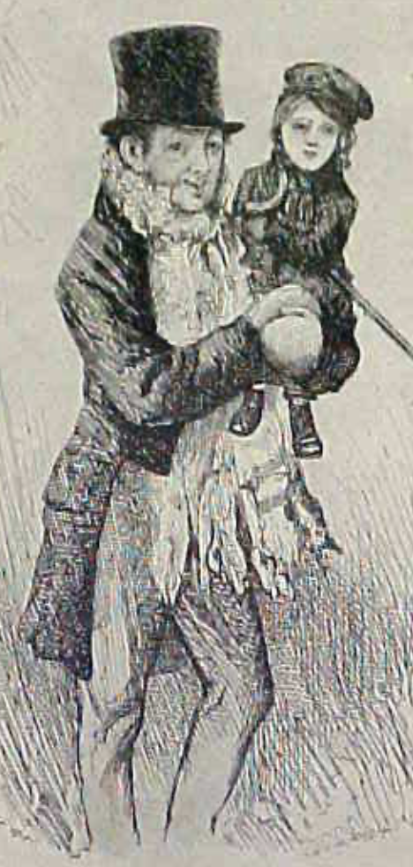
Review: The Watershed: 1870 as an Inflection Point
As of 1870, had the Industrial Revolution raised the standard of living or lightened the toil of the working class in England, the country at its center?
Yes
No
It’s not clear
Why? Malthusian forces—population explosion & thus smaller farm sizes. Growth, the growth had been slow 0.8%/year?

Slide 103
Globalization
Who called the era of globalization and growth from 1870 to 1914 an “economic El Dorado”?
Karl Marx
John Stuart Mill
Thomas Robert Malthus
John Maynard Keynes
None of the above
What would the others have said?

Slide 104
Migration
How many people of the roughly 1.5 billion then-population of the world left their continents of origin between 1870-1913?
10 million
50 million
100 million
200 million
400 million

Slide 105
Before 1870, Ideas Growth Not Fast Enough
And population growth accelerates as the world is not rich enough to undergo the demographic transition:
Value of useful and deployed ideas about technology and organization
-8000: 1
1: 3.5
1500: 4.75
1800: 9
1870: 16
2020: 421
Growth Rates:
-8000 to 1500: 0.02%/year
1500 to 1800: 0.2%/year
1800 to 1870: 0.8%/year
1870 to 2020: 2.3%/year
What caused these accelerations? What caused this last acceleration?

Slide 106
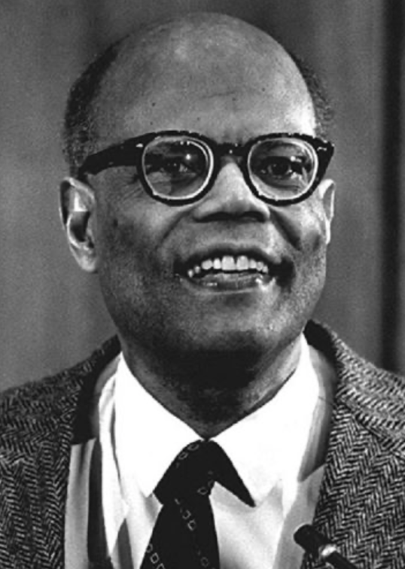
The Last Acceleration
The industrial research lab to routinize invention, and the modern corporation to routinize diffusion and deployment
Plus general purpose technologies—machine tools, non-human power sources
Arthur Lewis:
“New commodities: telephones, gramophones, typewriters, cameras, automobiles, and so on, a seemingly endless process whose latest twentieth-century additions include aeroplanes, radios, refrigerators, washing machines, television sets, and pleasure boats. Thus a rich man in 1870 did not possess anything that a rich man of 1770 had not possessed; he might have more or larger houses, more clothes, more pictures, more horses and carriages, or more furniture than say a school teacher possessed, but as likely as not his riches were displayed in the number of servants whom he employed rather than in his personal use of commodities…”
Not so much the particular technologies, as the grasping of the fact that there was a broad and deep range of new technologies to be discovered.
As much as it was new technologies, it was large-scale corporate organizations that could and did plan the division of labor to make use of and then market technologies.
And as much, it was that the global market meant that there was now a great deal of money to be made from the routinization of the exploration, development, and deployment of technological possibilities

Slide 107
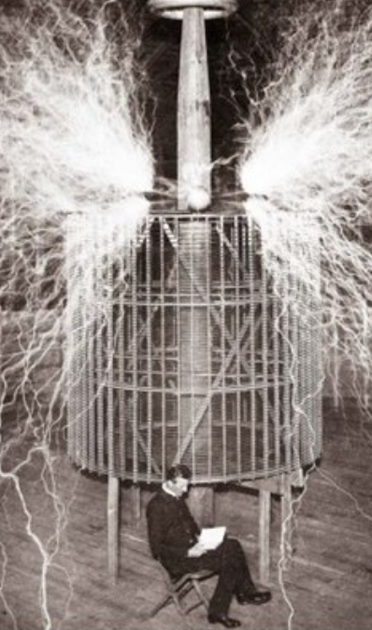
Who Is This Man?
And is he in any real danger?
Thomas Edison, and no
Andrew Carnegie, and no
Nicola Tesla, and no
Thomas Edison, and yes
Herbert Hoover, and yes

Slide 108
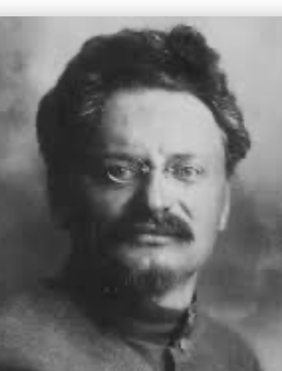
Lev Bronstein
Why did he say this?
“I had had no time to more than catch the general life-rhythm of the monster known as New York…”
“I left for Europe with the feeling of a man who has had only a peek into the furnace where the future is being forged…"

Slide 109
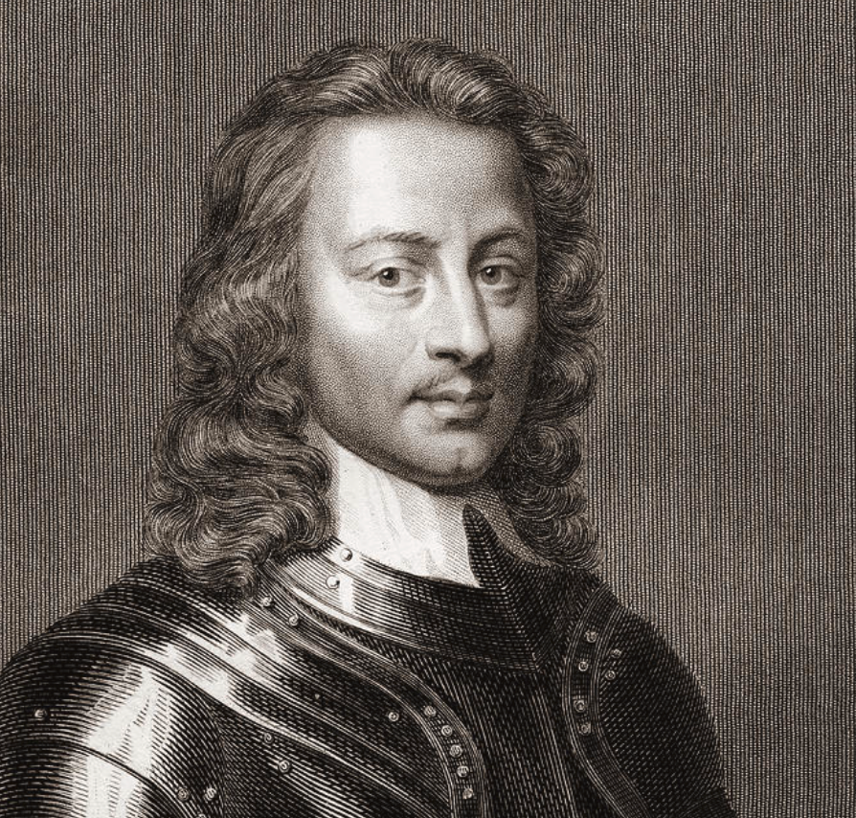
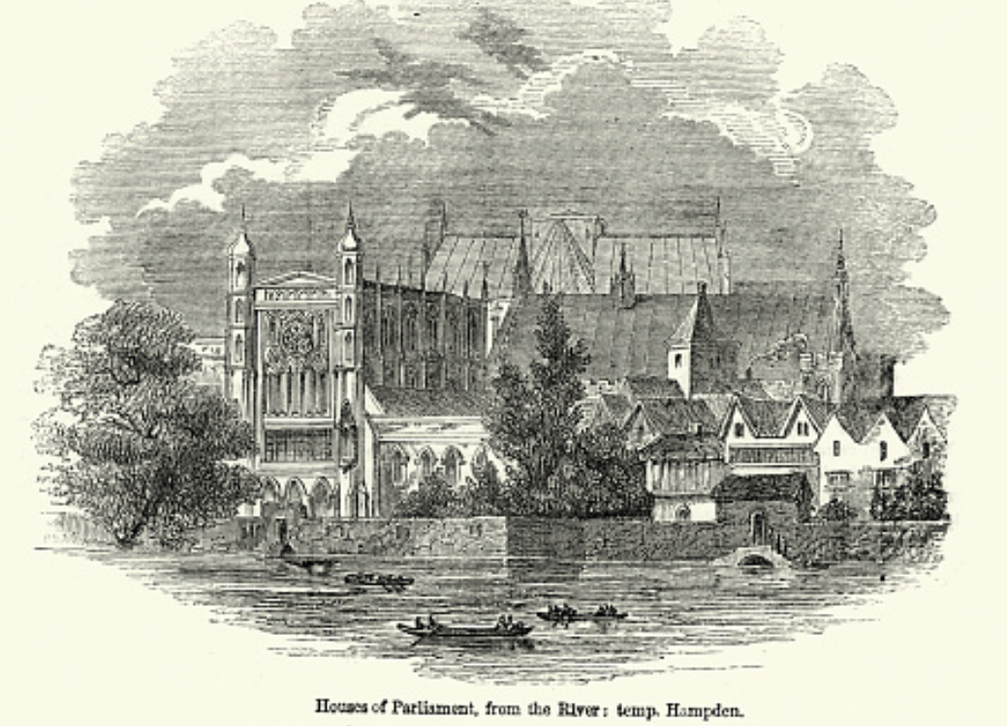
Review: Political Economy
From “Divine Right” and “Natural Order” to Enlightenment values…
Who was the first person to draft these words:?
“We hold these truths to be sacred & undeniable:
that all men are created equal & independant,
that from that equal creation they derive rights inherent & inalienable,
among which are the preservation of life, & liberty, & the pursuit of happiness;
that to secure these ends, governments are instituted among men, deriving their just powers from the consent of the governed…”
John Locke
Niccolo Machiavelli
Thomas Hobbes
Thomas Jefferson
George Washington
Why did he write them?

Slide 110
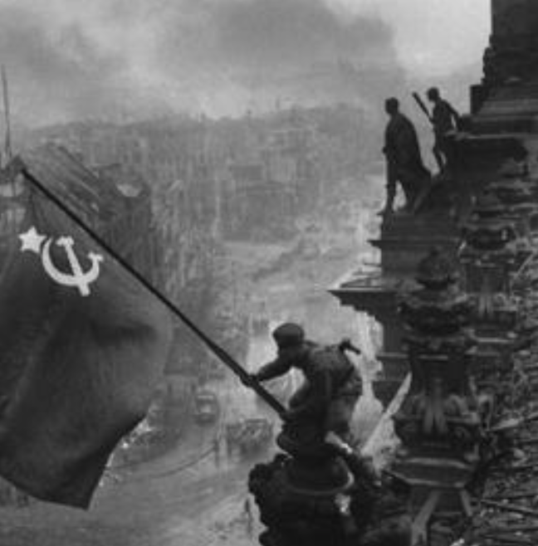
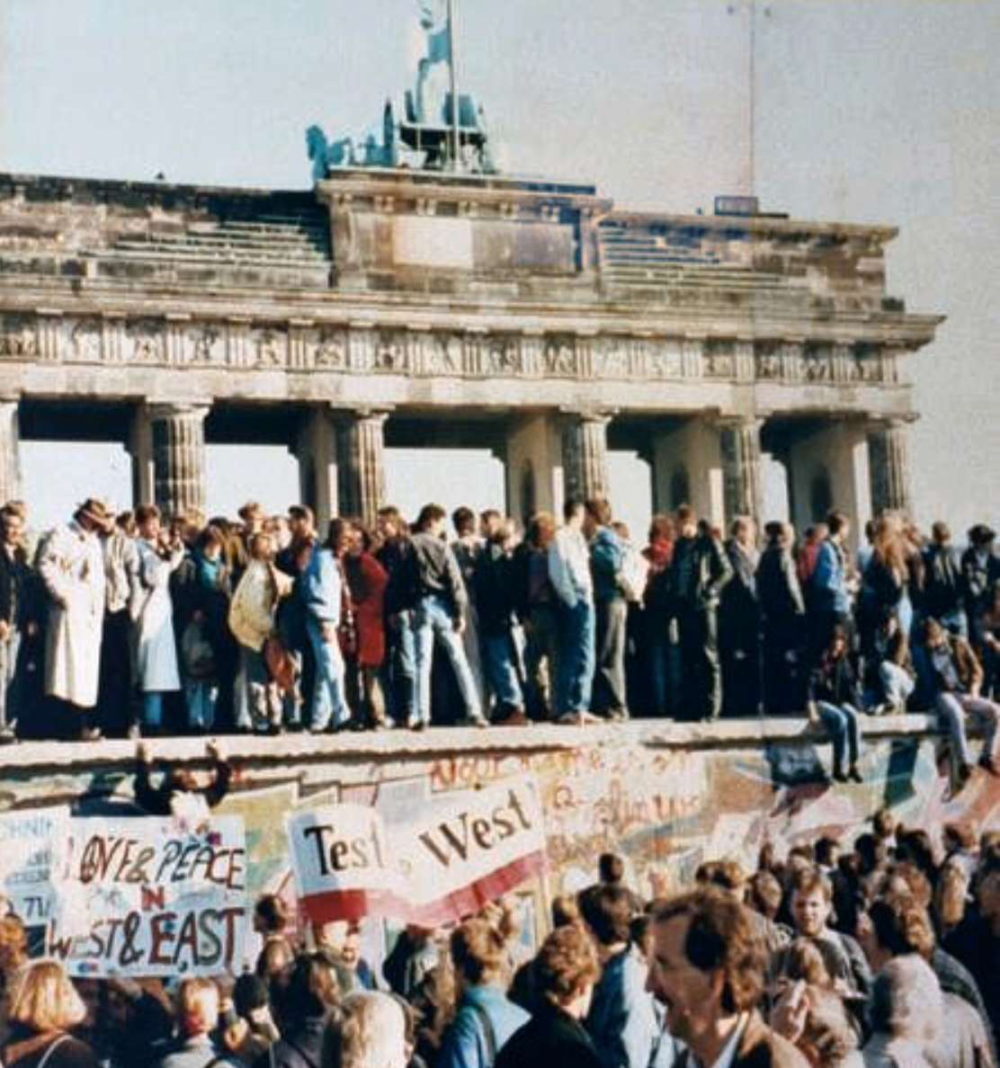
What Was the Proper Political Order?
Fears of “democracy” among American founders:
Madison: “Democracies have ever been spectacles of turbulence and contention... incompatible with personal security or the rights of property... as short in their lives as... violent in their deaths…”
Jefferson: “Gen’l Washington had not a firm confidence in the durability of our government… [& this] had some weight in his adoption of… ceremonies… calculated to prepare us gradually for a change which he believed possible…”
Hamilton: “the British government… best” as the only one “unit[ing] public strength with individual security…”
Adams: The American president should be announced as: “His Highness, the President of the United States, and Protector of the Rights of the Same…”
Question of political order thought settled: first in the rubble of Berlin in 1945, and then in the streets of East Germany in 1991:
Settled in favor of representative democracy, private property, & social insurance—late-1900s liberal democracy
But now reopened? Min Zhu (朱民) to me in 2015: “What are you Americans going to do to fix your broken political system?”

Slide 111
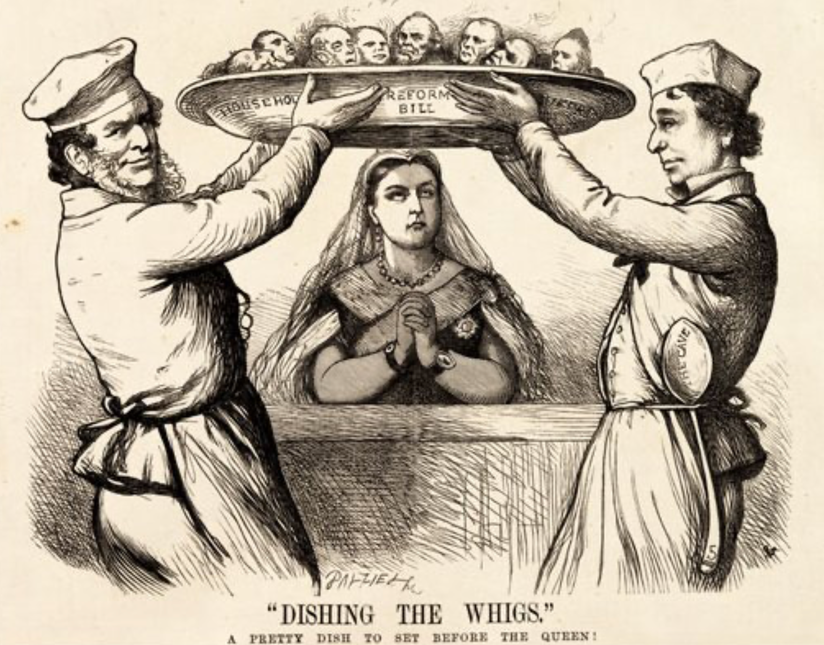
Franchise Restricted to the Rich Could Not Maintain Itself
The dynamic of franchise extension
Liberals in power would try extend on the principle that the new, poorer voters would be less conservative and would support them.
Threatening revolution would lead even conservatives to seek to extend the franchise in order to peel off of the revolutionary coalition those of the disenfranchised who had the most social power:
Earl Grey (yes, the tea): “The Principal… is to prevent… revolution…. I am reforming to preserve, not to overthrow…”
Charismatic leaders with popular followings would seek to give them votes, and then rule via plebiscites—going around the traditional elites
(Peculiar thing about Trump-Johnson: minority, and core is a minority of a minority…)
Conservatives: “dish the Whigs”—opportunities to form winning coalitions by appealing to those who were no profiting from the market economy, or felt that they were losing relative status in some ways…

Slide 112
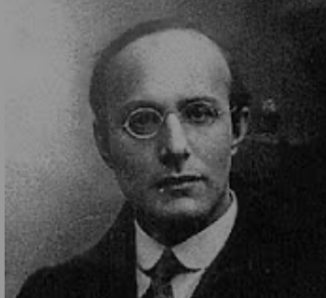
Popular Government and the Market Economy: Society’s Revenge
Karl Polanyi
People believe they have rights—to stable, supportive, nurturing communities; to incomes commensurate with their skills and status; and to money flows that will provide economic stability…
But a market society turns these things—land, labor, and finance—into commodities…
But they are not real commodities, they are fictitious commodities
And so you get your rights only if they satisfy a market profitability test
The only rights a market society respects are property rights:
& the only property rights that are worth anything are those that help you produce things for which rich people have a serious jones
Society will have its revenge: it will protect itself against the market logic, somehow, some way…

Slide 113
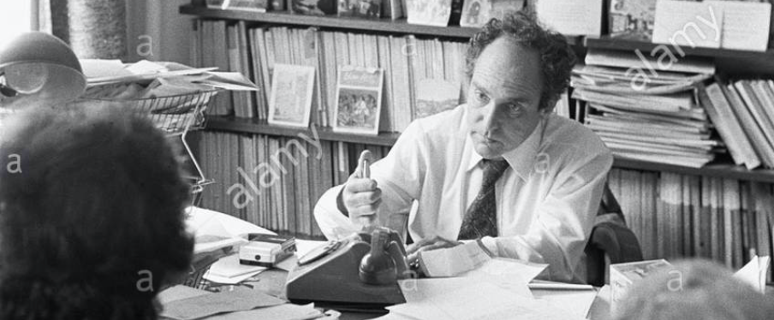
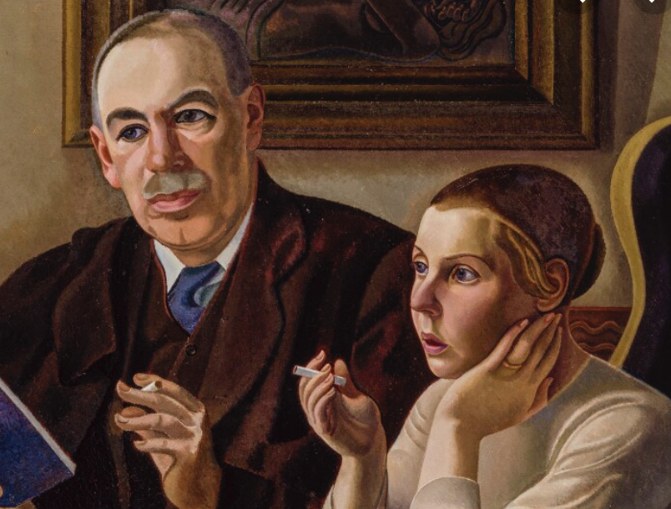

Digression: 5 Thinkers
Who shape my thought about the long 20th century—and how should, I think, shape yours
Beware! They are all deeply flawed…
But they are also geniuses, each in his way…
Beware of their followers! An iron law of ideology: a thinker’s most extravagant and aggressive followers will latch onto the stupidest and most shortsighted and wrong of their doctrines…
In historical order: Marx, Keynes, Hayek, Polanyi, Gellner
The other three thinkers:
Keynes: All that we need to produce general prosperity is technical adjustments to our system. Then the kingdom of freedom and prosperity will be within our grasp—and our major problems will no longer be economic ones
Gellner: The energy that most 19th century thinkers thought would go to “class“ went to “ethnos“ or “umma“ instead. The construction of ideological legitimations that makes sense both to dominants and to submissives who nevertheless believe they are part of some in-group is the key to understanding how societies stabilize themselves
Marx: Only the market economy will focus society’s energy on paying through the nose to boost the economy’s capital stock and to harvest the fruits of science and technology and then deploy them in production. But because the only demands in a market economy that matter are effective demands, the market economy also becomes a more “effective” means of slavery, for private property leads the proletariat to enslave themselves

Slide 114

Hayek and Polanyi
Thumbnails on our first two:
Hayek:
Only the market economy can use society’s knowledge.
But the market economy cannot produce “social justice” and should not be asked to try—in fact, we need to recognize that all we can attain is freedom, and that will bring general prosperity, but that justice will be forever outside our reach
Polanyi:
The market economy turns land, labor, and finance into “fictitious commodities”
Society will have its revenge via a “double movement”

Slide 115

Plus Tocqueville
Toqueville on the rich as “elder brothers” in 1848:
“In the country all the landed proprietors, whatever their origin, antecedents, education or means, had come together, and seemed to form but one class: all former political hatred and rivalry of caste or fortune had disappeared from view. There was no more jealousy or pride displayed between the peasant and the squire, the nobleman and the commoner; instead, I found mutual confidence, reciprocal friendliness, and regard. Property had become, with all those who owned it, a sort of badge of fraternity. The wealthy were the elder, the less endowed the younger brothers; but all considered themselves members of one family, having the same interest in defending the common inheritance. As the French Revolution had infinitely increased the number of land-owners, the whole population seemed to belong to that vast family. I had never seen anything like it, nor had anyone in France within the memory of man…”
“The territorial aristocracy of past ages… [was] obliged… to come to the help of its servants and relieve their distress” no such reciprocal ties of obligation bound the aristocrats of manufactures to their workers: thus “the manufacturing aristocracy which we see rising before our eyes is one of the hardest that have appeared on the earth…”

Slide 116

Plus Acheson
Dean Acheson, Secretary of State for Harry S Truman:
On the Republican Party as the party of wealth, enterprise, and opportunity:
“This business base of the Republican Party is stressed not in any spirit of criticism. The importance of business is an outstanding fact of American life. The achievements of business have been phenomenal. It is altogether appropriate that one of the major parties should represent its interests and its point of view…”
The subsequent transformation of the Republican Party from those who were going to become millionaires, or become even greater millionaires; to those who fear that they would lose it all…

Slide 117
Skipped Topic: Pre-1914 Political Economy: Over in Europe
The June Days of 1848 in Paris:
Tocqueville:
“The insurrection of June [1848]... class against class... a blind and rude, but powerful, effort on the part of the workmen to escape from the necessities of their condition, which had been depicted to them as one of unlawful oppression…. The closing of the national workshops… occasioned the rising…”
“Thousands… hastening to our aid from every part of France.... Thanks to the railroads, some had already come from fifty leagues’ distance... every class of society... peasants... shopkeepers... landlords and nobles all mingled together... they rushed into Paris with unequalled ardour: a spectacle as strange and unprecedented in our revolutionary annals.... The insurgents received no reinforcements, whereas we had all France for reserves…”

Slide 118
French Politics
Régimes stability is not on the menu:
the terrorist dictatorship of the Jacobins (the mainspring of popular government… amid revolution it is at once virtue and terror: virtue, without which terror is fatal; terror, without which virtue is impotent…)
a corrupt and gerrymandered 5-man executive of the Directory, defended on October 5, 1795 by the “whiff of grapeshot” of Napoleon Bonaparte and Joachim Murat, that managed to generate the first modern hyperinflation, defended itself against a royalist coup plotted by two of its five members (Barthelemy and Carnot) and its most successful general (Pichegru), and was then overthrown by the same Napoleon in 1799.
a dictatorship, with Napoleon Bonaparte as “First Consul”, until 1804.
an empire, with Napoleon Bonaparte as Emperor of the French, until suppressed by the other European powers in 1815.
a restored Bourbon monarchy, with first Louis XVIII and then Charles X, until 1830.
an alternative Orleanist monarchy, with King Louis-Philippes as the king-citizen, overthrown in 1848.
a second republic, overthrown by its own president, Napoleon’s nephew Louis Napoleon, which collapsed under pressure of military defeat in 1870.
a socialist commune, in Paris at least.
a third republic, which suppressed the commune—but promptly chose a royalist Marshal MacMahon, as president.
a failed attempt by third republic president Marshal MacMahon to replace himself by a King Henry V.
a failed attempt by the ex-Minister of War Georges Boulanger to seize power for his RRR movement: Revanche, Révision, Restauration (revenge on Germany, revision of the constitution, restoration of the monarchy).

Slide 119
Left-Wing Normal European Politics I
Disjunction between policies and rhetoric:
The Socialist Party of Germany’s Erfurt and Gotha programs seek things like: holidays for elections, two-year legislative terms, the right to bear arms, equal rights for women, the prohibition of spending public funds for religious purposes, free public schools and colleges, free medical care including midwifery, an eight-hour working day, no child labor under 14, a 36-hour minimum weekend, an occupational safety and health administration…

Slide 120
Left-Wing Normal European Politics II
Disjunction between policies and rhetoric:
But also: “By every lawful means to bring about a free state and a socialistic society, to effect the destruction of the iron law of wages by doing away with the system of wage labor.” And they sought: “the transformation of the capitalist private ownership of the means of production—land and soil, pits and mines, raw materials, tools, machines, means of transportation—into social property and the transformation of the production of goods into socialist production carried on by and for society.” And they believed: “This… emancipation… of the entire human race…. But it can only be the work of the working class, because all other classes… have as their common goal the preservation of the foundations of contemporary society.”

Slide 121
Center and Right-Wing Normal European Politics
The touchstone was “fairness”: it was not fair that those who did not work hard and did not play by the rules got lots of good things:
Those who did not play by the rules could be on either end of the wealth-and-power spectrum:
Parasitic aristocrats and cruel plutocrats
Those poor who wanted something for nothing, or got above their station
A middle-class, social order movement
Focus voters’ attention on the disruptive utopian aspirations of the left, and electoral coalitions could be preserved…
Preserve as much as possible of old orders of hierarchy in changing times:
Reform to preserve; change so things could stay the same
Find new reasons why hierarchy is good: social darwinism

Slide 122
Magnifying Non-Economic Cleavages Had Dangers
Society under threat not by economic inequality but by social disorder—or aliens—or other nations. Plus:
A right-wing landed and bureaucratic upper class that had, by and large, lost its social role.
A belief by politicians anxious to paper over class divisions that they could be papered over with national or ethnic unity.
A growing social-darwinist current that struggle was good, and the victors should be rewarded
Even or especially military struggle by peoples-in-arms, over not what language a province would be administered in but who would live there
These stored up trouble as 1914 approached.
In 1919 John Maynard Keynes was to write, bitterly, that he, his peers, and his elders had regarded:
“the projects and politics of militarism and imperialism, of racial and cultural rivalries, of monopolies, restrictions, and exclusion, which were to play the serpent to this paradise… [as] little more than the amusements of his daily newspaper…”

